Slide 1
Charge Predictor
Predicting Molecular Properties
By: Rueen Fiez & Parth Patel

Slide 2
Overview
The challenge
Our solution
Conclusions

Slide 3
The Challenge
The challenge is listed on Kaggle by the members of CHemistry and Mathematics in Phase Space(CHAMPS) at the University of Bristol
Nuclear Magnetic Resonance(NMR) provides researchers with insight into molecule’s structure and dynamics allowing them to understand how the 3D structure of a molecule affects its properties and behaviour. This will enable researchers to make progress in a range of important problems within the environmental, pharmaceutical and materials science spaces to name a few
Our goal is to develop an algorithm that can help predict the magnetic interaction between two atoms in a molecule(i.e., the scalar coupling constant)

Slide 4
Machine Learning Life Cycle
Implement & Submit
Project Objectives
Charge Predictor
Evaluate & Interpret results
Acquire & Explore Data
Model Development

Slide 5

Project Objectives
Develop an algorithm which will predict the magnetic interaction between a pair of atoms, otherwise known as the scalar coupling constant
This magnetic interaction depends on intervening electrons and chemical bonds that make up a molecule’s 3D structure

Slide 6
Acquire & Explore Data
We acquired our data from the kaggle competition page provided by the Members of the CHemistry and Mathematics in Phase Space(CHAMPS)
Separated and focused on the important columns
Exploratory Data Analysis
Training Data observations : 4658147
17 features
Test Data observations : 2505542
13 features(4 features are missing in test)
Number of unique molecules in train : 85003
Number of unique molecules in the test data : 45772
The train.csv includes information at the molecule level including the y-target(scalar coupling constant for each atom pair)
The provided data also comes with a structures.csv file which provides the cartesian coordinates for each molecule’s atoms

Slide 7
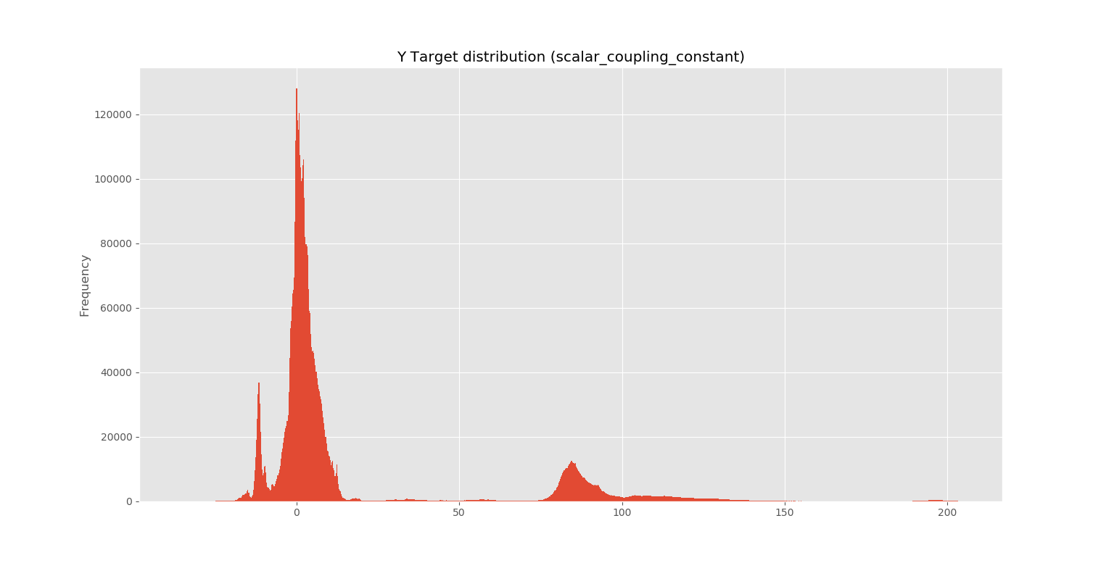
Acquire & Explore Data

Slide 8
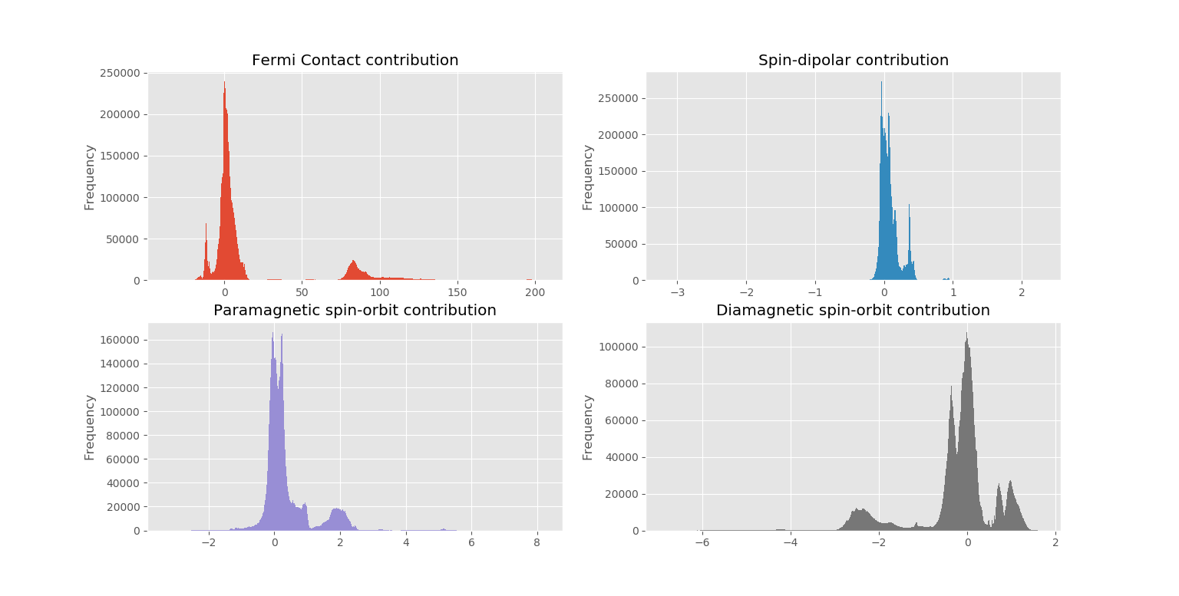
Acquire & Explore Data

Slide 9
Feature engineering
Feature engineering was required to calculate the distances between atoms and other metrics of importance such as atom mean distances, atom distance standard deviation, etc.
Due to the missing four features between the test and train files our initial focus was to predict the missing features and include them into the test file first before using the test file for predictions against the final model
The y-target value is comprised of the sum of the four missing features
The 4 Features:
FC - Fermi Contact contribution
SD - Spin-Dipolar contribution
PSO - Paramagnetic spin-orbit contribution
DSO - Diamagnetic spin-orbit contribution
Our Train and Test file will ultimately have 59 features post feature engineering

Slide 10
Solution Overview
Here is the High-level breakdown of our solution’s process
Data Loading
Exploratory Data Analysis
Feature Engineering
Preprocessing
Model Development and Evaluation
Export Results

Slide 11
Model Development
Pipeline/Preprocessing
Simple Imputer, Standard Scalar, Label Encoder, PCA*
Ensemble models leveraged
Random Forest Regressor algorithm used
K-fold, cross validation used for evaluation
Preprocess train data using pipeline
Predict missing features using train data and random forest Model
After adding missing features Preprocess data for the missing features via pipeline
Train final Ensemble Model now using full feature set
Predict scalar coupling constants(y-target) using augmented test file
Model for the highly correlated ‘FC’ feature has a Mean Square Error score of 6.87 and Standard Deviation of 0.535

Slide 12
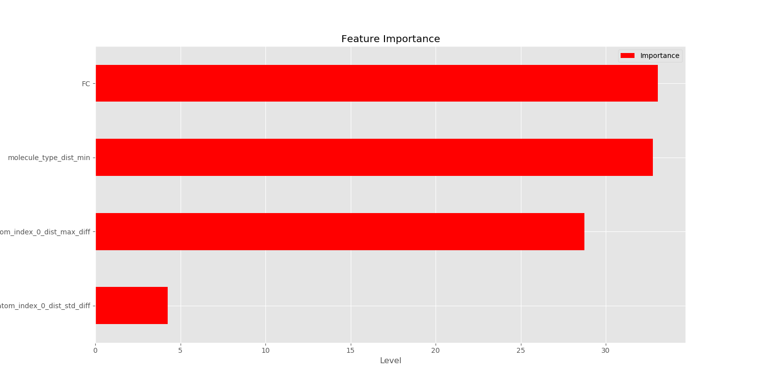
Evaluation -> (Final Group MAE Score - 1.43)

Slide 13
Implement & Submit
Kaggle leaderboard rank – 2296 out of 2499 teams
Future recommendations to improve score and rank
Different types of dimensionality reductions
Different algorithms
Model per molecule
Additional features for feature engineering
Post a Kaggle Kernel

Slide 14
References
Github link: https://github.com/rfiez/uoft_ml_proj1
Youtube link: https://www.youtube.com/watch?v=gXc-S-7TlyE&feature=youtu.be

